Slide 1


PSG – TI
EMBEDDED PROCESSING PROJECT
DEPARTMENT OF ECE
PSG COLLEGE OF TECHNOLOGY
COIMBATORE
Faculty Mentors:
Dr. Sivaraj
Dr. A.UMA
Department of ECE
Presented by,
Akshay Muthu Shankar G (22L106)
Darshana R (22L210)
Sakthi Lakshmi S (22L263)
Bhavaneeshwari (24MV02)

Slide 2
I2C Protocol Implementation
Custom I²C Driver on 8051 – Low-Level Implementation for Peripheral Communication

Slide 3
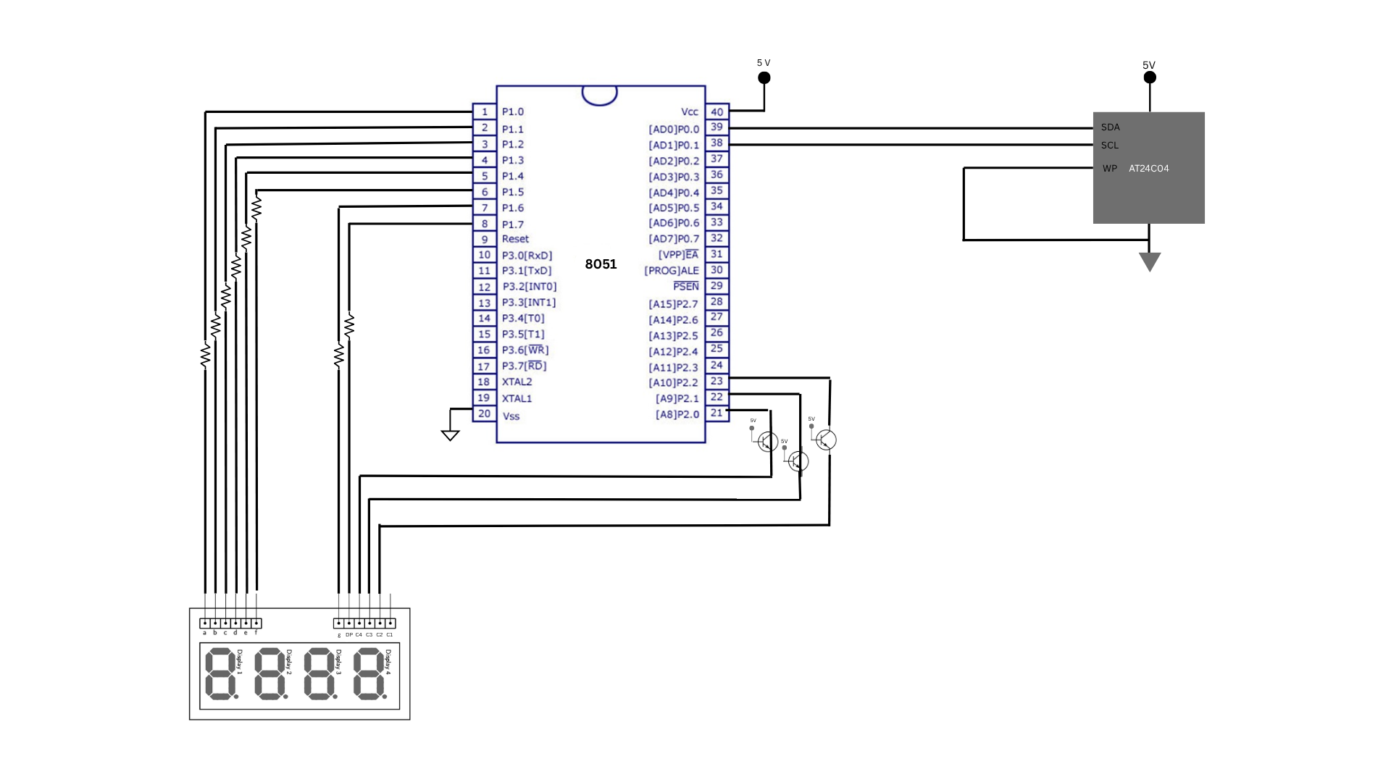
CIRCUIT DIAGRAM

Slide 4
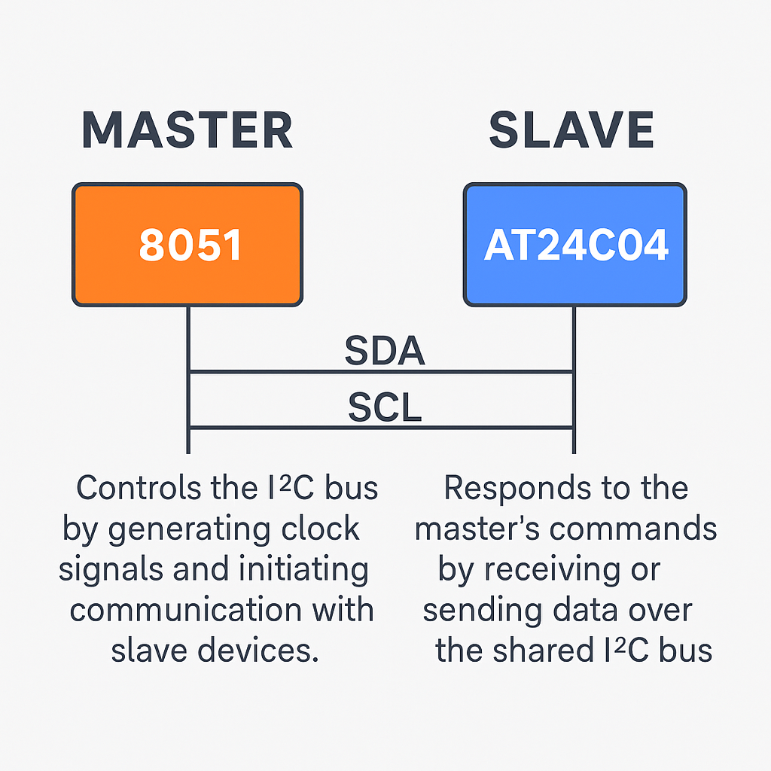
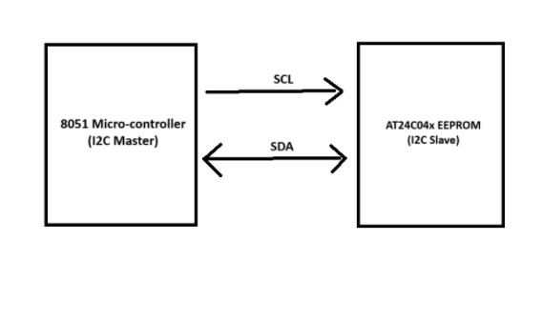
Pin Configuration and Connection
Serial Data – P0.0
Serial Clock – P0.1
Push Button – P0.7

Slide 5
Result & Inference
Inference:
Demonstrated low-level I²C protocol handling through GPIO bit-banging on 8051.
Validated EEPROM read/write functionality with ACK/NACK handshaking.
Real-time embedded persistence achieved using non-volatile memory.
Project lays a strong foundation for future SPI and USB driver implementation in industrial systems.
📂 Video Link:
https://drive.google.com/file/d/19g_A_HL4602ZP7045coCjJd3yxQTnCnr/view?usp=drive_link

Slide 6
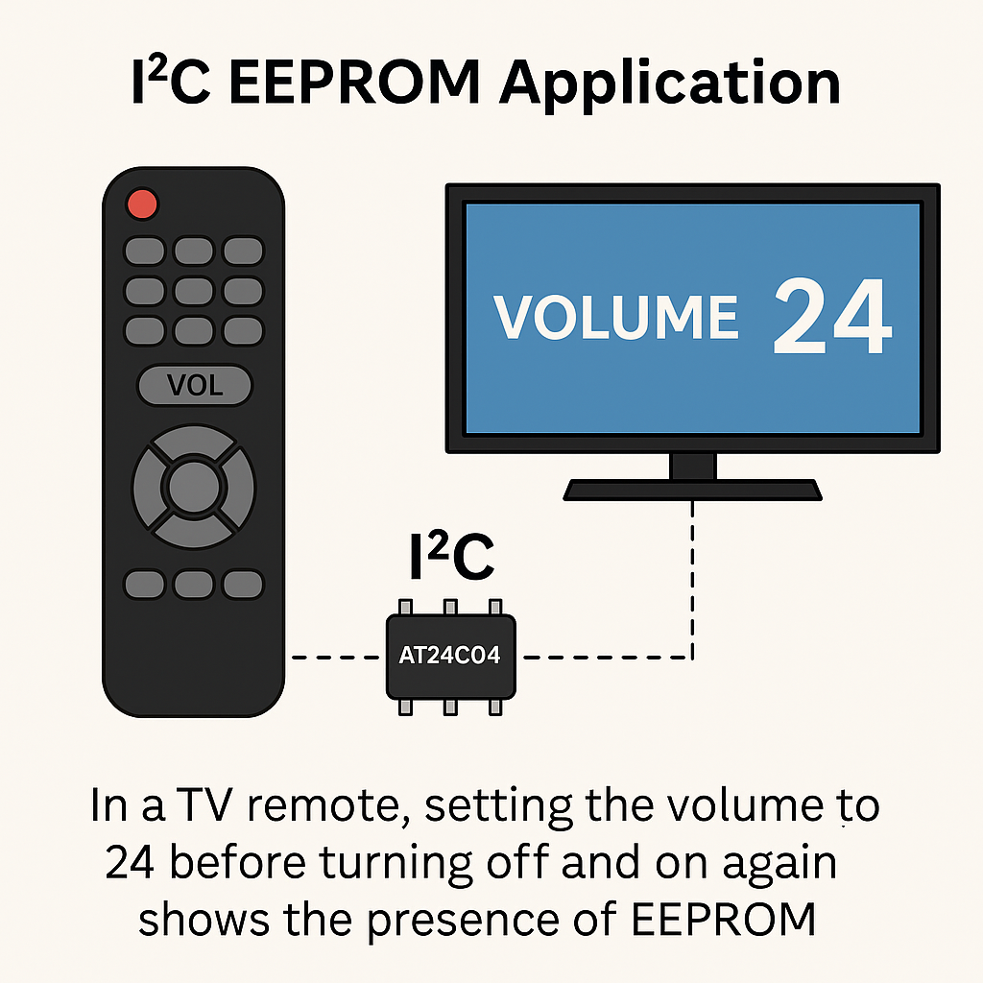
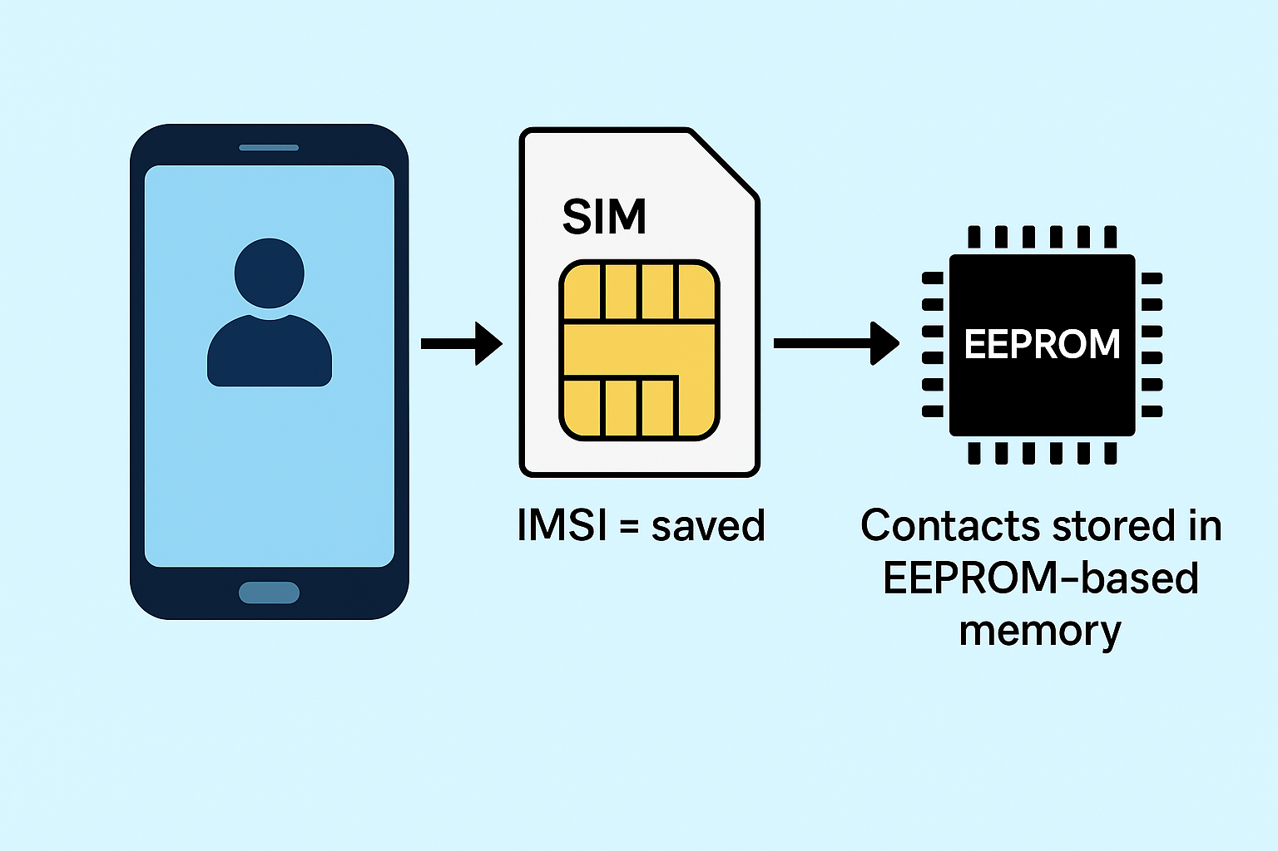
Applications:
📂 Source Code Repository:
🔗 i2c-eeprom-8051
References:
🔗 I2C-bus specification and user manual
🔗 I2C EEPROM AT24C04 Datasheet

Slide 7
SPI PROTOCOL IMPLEMENTATION
Objective: To display the temperature data from BMP280 sensor using 8051 through SPI protocol

Slide 8
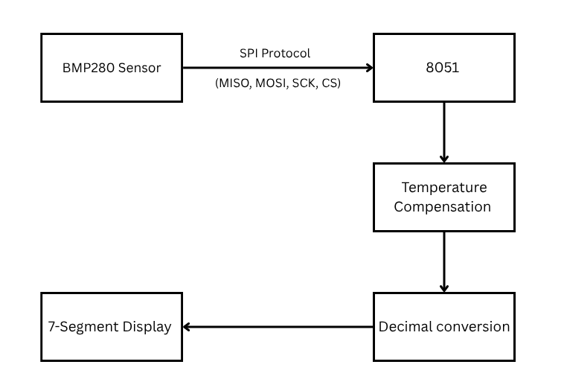
BLOCK DIAGRAM

Slide 9
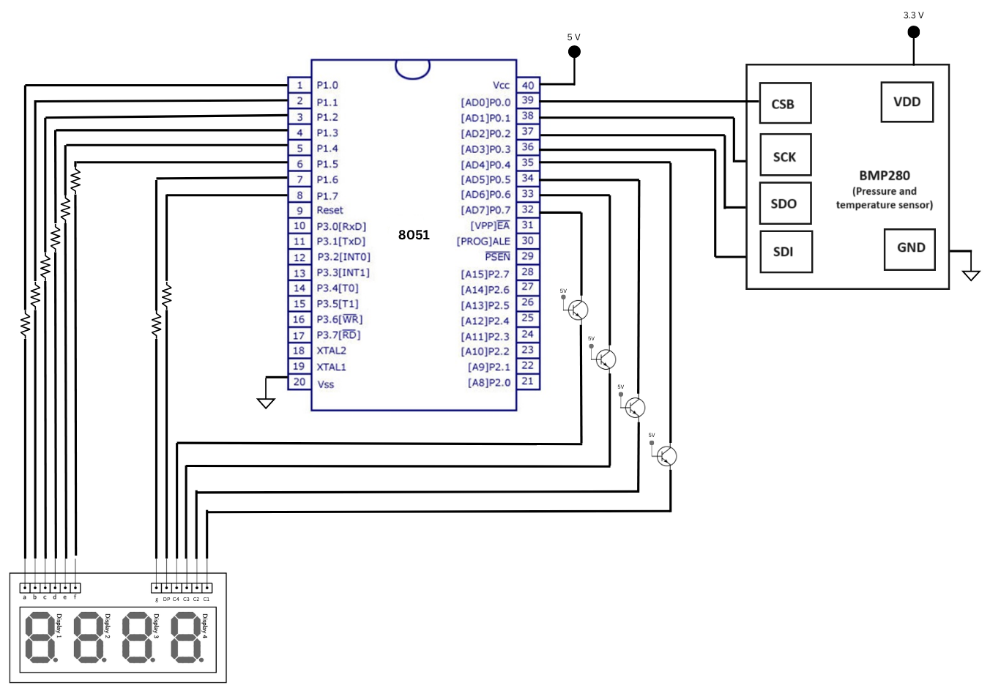
CIRCUIT DIAGRAM

Slide 10
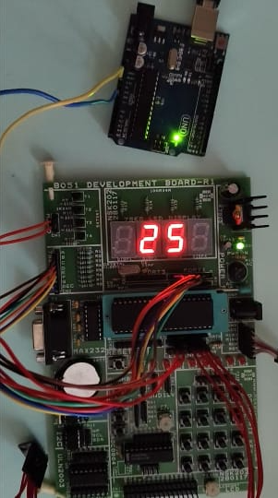
BOARD

Slide 11
VIDEO
https://drive.google.com/file/d/1h0Bjh27i1lloxT9Ed- Y9yNvXed3KhbEz/view?usp=sharing

Slide 12
SOURCE CODE
🔗 SPI_BMP280

Slide 13
Controlling 8051 using CP2102 via USB

Slide 14
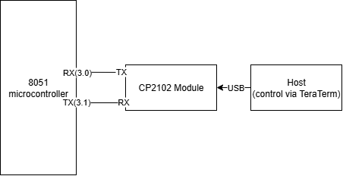
Block Diagram

Slide 15
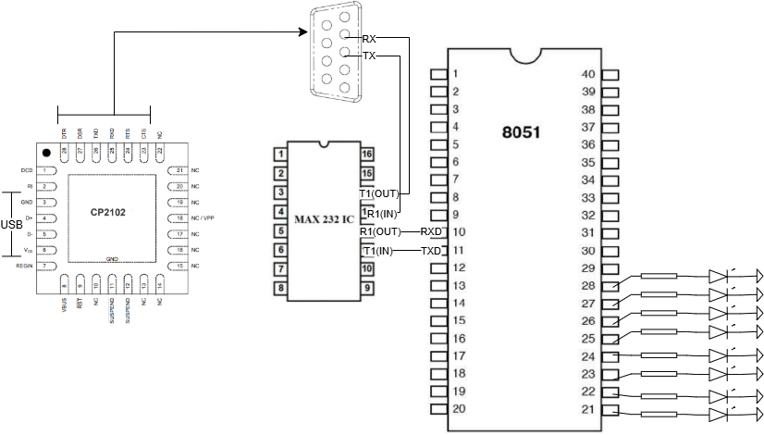
Circuit Diagram

Slide 16
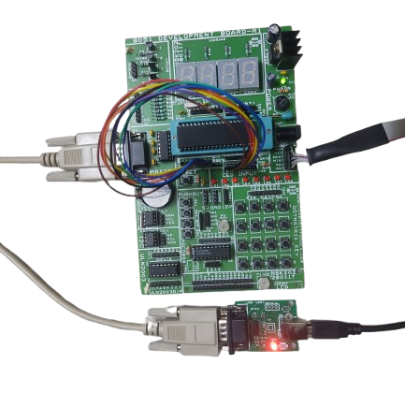
Implementation

Slide 17
Video
https://drive.google.com/file/d/1oPDg7hd8mQyi-jHbifvkB72aJ3sEAxqL/view?usp=drive_link

Slide 18
SOURCE CODE
🔗 cp2102_8051

Slide 19
Embedded System Design
In Zynq using VIVADO

Slide 20
BLOCK DIAGRAM
PS
PL
ARM CORTEX
A9
M_AXI_GPO
AXI
INTER-
CONNECT
BLOCK
RS232
UART
AXI4-Lite
LED_IP
LED
AXI4-Lite
AXI4-Lite
GPIO
DIP_SWITCHES
AXI4-Lite
GPIO
BUTTONS

Slide 21
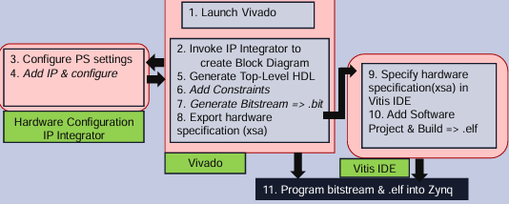
Embedded System Design Flow

Slide 22
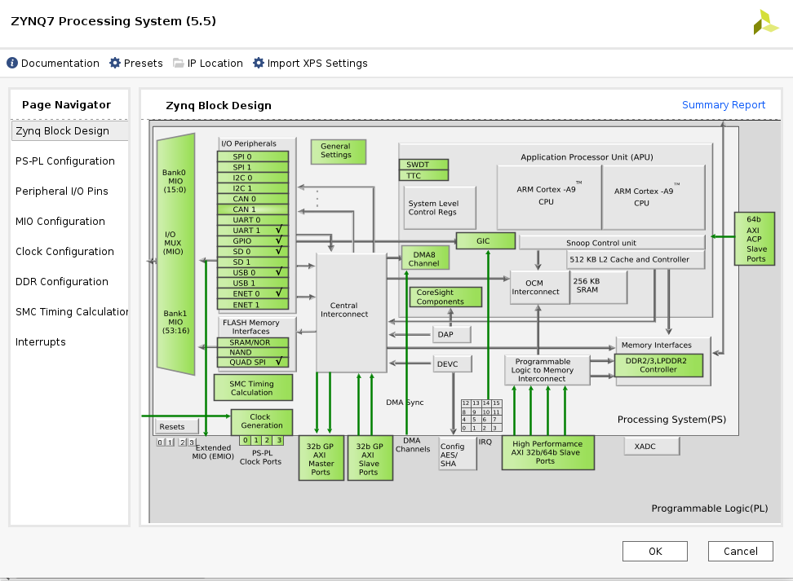
CONFIGURE PS

Slide 23
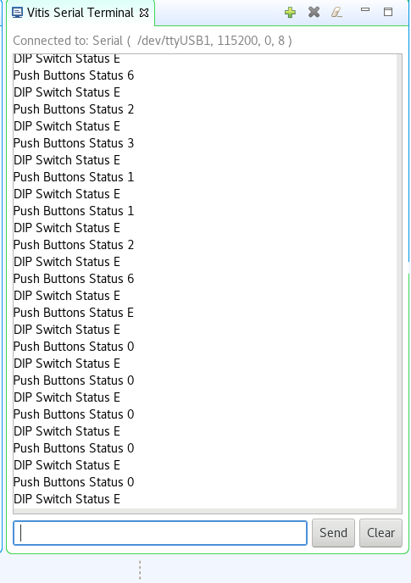
VITIS SERIAL TERMINAL

Slide 24
Video
https://drive.google.com/drive/folders/1Fw1ExKZlWjX4UmAFWkQHIaQUCQIeB23R

Slide 25
SOURCE CODE
🔗 pc_to_zync

Slide 26
REFERENCES
https://xilinx.github.io/xup_embedded_system_design_flow/presentations.html

Slide 27
Thank You

